Slide 1
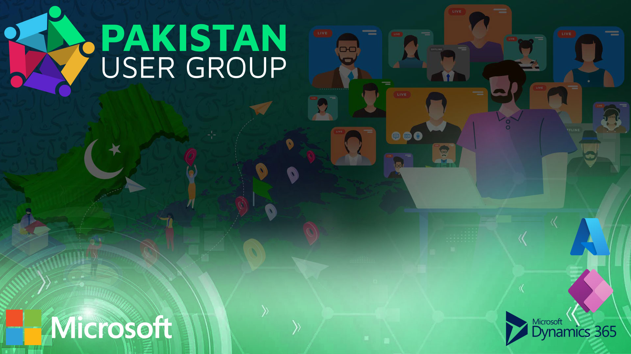
Welcome Microsoft Business Applications
F&O Lecture 1: Get started with finance and operations apps
Notes:
Welcome and Thank you for joining us today
Before we start some house keeping and basic check
Can you all hear me clearly and see my screen ?
Please stay mute if you are not speaking.
We will make the session as much as interactive but in case you have a question, please hold it until we get into Q&A session or drop the question in the chat so that one of moderator can response in the meantime.
Use the hand raise functionality if you want to speak up
I will keep it to basic to ensure everyone gets on the same page as we go along through the training sessions.

Slide 2

AGENDA
Quiz
ERP (Benefits, Challenges, Implementation)
MS Dynamics 365 F&O
Microsoft Learn

Slide 3

Quiz (Based on Previous Lectures)
http://tiny.cc/Fast-DT-Q1

Slide 4
What is ERP?
ERP software automates core business processes, offering optimal performance and data coordination.
It integrates diverse functions like finance, supply chain, operations, reporting, and HR on a unified platform.
ERP ensures agility and efficiency by evolving with a company's growth and adapting to changing needs.
Modern ERP software systems
Traditional ERP systems operated in isolation, requiring complex customizations and hindering technology adoption.
Modern ERP software integrates processes seamlessly, not just within the ERP system, but also with productivity tools, e-commerce, and customer engagement solutions.
It provides better insights, process optimization, flexibility, security, and resilience, fostering innovation while preparing for the future.

Slide 5
Why is ERP important for business?
Advancing ERP technology integrates processes for improved business intelligence, speed, and operational optimization.
Here are three ways an ERP system can improve your business:
Drive optimal performance : With solutions that use AI, you’ll access insights that enhance your decision making and reveal ways to improve operational performance going forward.
Accelerate operational impact. By connecting processes and data, you’ll bring more visibility and flexibility to employees, helping them take action quickly and deliver more value across the business.
Ensure business agility. Many ERP solutions are built to adapt to your needs and grow with you, helping you proactively prepare for—and readily respond to—any operational disruption or market change.

Slide 6
What business functions can be optimized with ERP?
ERP systems unify core organizational functions, erasing front-back office barriers, and flexibly align with evolving business priorities. Key functions include:
Commerce : ERP enhances customer experiences through AI recommendations for retailers.
Finance : ERP enhances profitability, compliance, and accessibility through AI, automation, and tracking.
Human resources : Current solutions use data to streamline employee management.
Manufacturing : ERP streamlines communication, efficiency, and management with RPA, real-time data, and optimization.
Supply chain: ERP automates manual processes and saves time and costs.

Slide 7
Three signs that you need ERP software
The basics aren’t letting you grow : If basic tools are restricting market expansion and global growth, consider upgrading to a flexible ERP system to overcome limitations.
You’re dealing with disparate systems : Incompatible disparate systems prompt a shift to an integrated ERP solution, avoiding wasted time and resources on patchwork solutions.
You can’t meet customer expectations : To address mobility needs for both staff and customers, investing in an accommodating system ensures competitive edge by empowering staff and meeting customer expectations.

Slide 8
Three ERP implementation challenges for businesses
Choosing the right ERP solution : Selecting the right ERP system and technology partner unifies existing business processes, providing a cohesive platform for shared information across the organization without seeking a perfect solution.
Affording the cost of an ERP system : Adopting ERP doesn't require an all-in approach; modular software solutions can be acquired based on business needs, allowing gradual implementation and avoiding major investments without assured benefits.
Integrating new ERP software with existing software : A suitable ERP solution integrates existing processes and anticipates future growth, offering relevant features such as robust business intelligence for enhanced financial, supply chain, and manufacturing management.

Slide 9
Get started with finance and operations apps
Introduction to Microsoft Dynamics 365
Get started with Dynamics 365 Finance
Get started with Dynamics 365 Supply Chain Management
Get started with production control in Dynamics 365 Supply Chain Management
Introduction to Dynamics 365 Commerce
Get started with Dynamics 365 Human Resources
Get started with Dynamics 365 Project Operations
Get help and learn more about finance and operations apps

Slide 10
Introduction to Microsoft Dynamics 365
Microsoft business apps foster ongoing, personalized engagements with data-driven insights.
Microsoft business applications provide real value and impact to organizations through:
Omnichannel applications, turning single interactions into recurring engagements.
Intelligent services, providing prescriptive guidance to help drive better business outcomes.
Integrated cloud platform, unifying people, processes, and data for a 360-degree view of customers and operations.
Flexible solutions, enabling businesses to scale and thrive under change.
This Module includes:
Explore Dynamics 365 applications.
Discover business value in Dynamics 365 applications and how they support digital transformation.
Learn about the role of artificial intelligence (AI) and mixed reality in Dynamics 365.

Slide 11
Digital transformation is business transformation
Dynamics 365 business applications facilitate digital transformation by unifying CRM and ERP functions into modern, modular solutions on a single platform, enabling adaptable technology adoption for enhanced business results.
Through Dynamics 365 business applications, organizations can:
Engage customers and build relationships with personalized experiences using data-driven insights.
Optimize operations boost efficiency, and cut costs through embedded intelligence.
Empower employees with workplace-accessible data for better talent management.
Transform products and services, leveraging data for innovation and customer-centric experiences.
Business Central - Microsoft Dynamics 365 Business Central streamlines business processes, automating and managing operations for small and mid-sized organizations.

Slide 12
Artificial intelligence
Artificial intelligence (AI) employs algorithms to analyze data and draw conclusions, capable of self-training or continuous refinement with feedback.
AI in Dynamics 365
In Dynamics 365 Commerce, AI-powered Dynamics 365 Fraud Protection safeguards e-commerce businesses and customers from fraud, reducing costs, boosting revenue, and enhancing shopping experiences.
In Dynamics 365 Customer Service, Dynamics 365 Virtual Agent for Customer Service uses AI to provide exceptional customer service with intelligent, adaptable virtual agents.
In Dynamics 365 Sales, Dynamics 365 Marketing, and Dynamics 365 Customer Service, Dynamics 365 Customer Insights uses AI to create an intuitive and flexible customer data platform that unlocks insights and powers personalized customer experiences.
Mixed reality
It merges physical and digital realms, revolutionizing human-computer-environment interaction with unprecedented potential.

Slide 13
Get started with Dynamics 365 Finance
Introduction
Enhanced Decision-Making: Leverage adaptable finance tools, built-in analytics, and industry relevance in Dynamics 365 Finance for informed choices.
Efficient Financial Management: Achieve robust accounting, reporting, and compliance with streamlined account updates through Dynamics 365 Finance.
Benefits of Dynamics 365 Finance
Accelerate your business growth
Elevate your financial performance

Slide 14
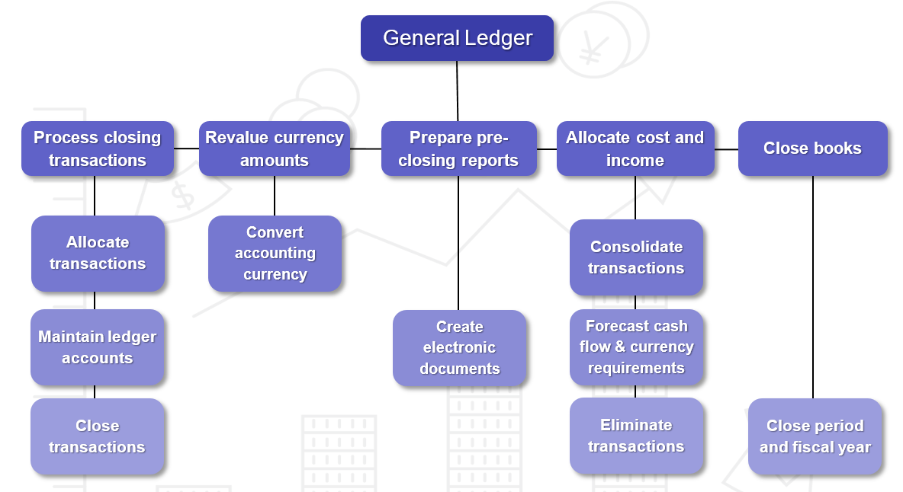
General Ledger : You can use the General ledger module in Finance to define and manage the legal entity's financial structure. The general ledger is a register of debit and credit entries.

Slide 15
Cash and bank management : This management module is used to Finance & maintain a company's bank accounts and the financial instruments that are associated with those bank accounts.
Tax : Every company must collect and pay taxes to various tax authorities. The rules and rates vary by country or region, state, county, and city.
Accounts payable : The Finance AP module sets up vendor info, payment options, and more.
Accounts receivable : Use the Accounts receivable module in Finance to track customer invoices and incoming payments.
Credit and collections : Accounts receivable collections information can be managed in one central view by using the Collections page in Finance.
Budgeting : A proper budgeting process can help companies forecast and track their spending.
Fixed assets : They are items of value, such as buildings, vehicles, land, and equipment, that are owned by an individual or a company.
Cost accounting : Cost accounting collects data from general ledger, subledgers, budgets, and statistical information.
Electronic invoicing : Electronic invoicing for D365 Finance and SCM is a scalable solution for e-invoicing.

Slide 16
Get started with Dynamics 365 Supply Chain Management
Introduction
This module introduces the distribution and trade features of Supply Chain Management and their related modules.
In this module, you will:
Learn the benefits of distribution and trade in Supply Chain Management.
Get an overview of distribution and trade features in Supply Chain Management.

Slide 17
Benefits of Supply Chain Management :
Create an ideal manufacturing mix from discrete, lean, and process in a single solution to support processes across the supply chain.
Optimize manufacturing parameters for each product family.
Streamline scheduling with real-time visibility into resources.
Optimize the flow of manufacturing material and finished.
Improve product quality by identifying and resolving issues through real-time insights and predictive intelligence.
Automate and streamline your supply chain
Supply Chain Management helps organizations optimize fulfillment and reduce costs by synchronizing logistics across sites, warehouses, and transportation modes.

Slide 18
Overview of Supply Chain Management
Distribution and trade in SCM is organized by tasks and roles.
By using the Procurement and sourcing module in Supply Chain Management, you can perform all purchases, negotiate and create purchase agreements.
Cost accounting
Cost accounting lets you collect data from various sources, such as the general ledger, sub-ledgers, budgets, and statistical information.
Cost management
Cost management in Supply Chain Management lets you work with the valuation and accounting of raw materials.
Inventory management and Warehouse management
Inventory management and Warehouse management modules to perform the following tasks:
Inbound operations
Quality assurance
Warehouse operations
Outbound operations
Inventory control

Slide 19
Master planning
Master planning assesses the following:
Raw materials and capacities that are currently available.
Raw materials and capacities that are required to complete production. For example, determining what must be manufactured, purchased, transferred, or set aside as safety stock before you can complete production.
The Master plan calculates net requirements on day-to-day bases.
Procurement and sourcing
Procurement and sourcing is the process of acquiring products and services.
Vendor collaboration
Vendor collaboration interface in SCM exposes purchase orders, invoices, consignment stock, RFQs.
Sales and marketing
Within the Sales and marketing module, users can store and use data related to their relationships with leads, opportunities, customers, and prospects.
Customer portal
Customer portal in Power Pages creates external website for SCM customers.

Slide 20
Product information management
Product information is centrally managed in supply chain and retail apps.
Shared product definitions improve business process management.
A product is primarily defined by a product number, name, and description.
Production control
Production life cycle begins with an order and ends with manufacturing.
The production life cycle is a series of steps with different information requirements.
Production control linked to other modules such as PIM, Inventory, GL, Warehouse, Project, and Organization.
Intercompany trade
SCM facilitates intercompany trade, saving time and money.
All documents are automatically generated for the participating legal entities.
Warehouse management
Elevate warehouse management with seamless mobile integration in Supply Chain.
Seamless integration: Warehouse management at the core of end-to-end Supply Chain processes

Slide 21
Transportation management
Efficient Transportation Management: Streamlined control for inbound and outbound logistics in your Supply Chain. Practice Lab: Lab - Explore Dynamics 365 Supply Chain Management

Slide 22
Get started with production control in Dynamics 365 Supply Chain Management
Introduction
"From creation to completion: Diverse production processes mapped in a progressive lifecycle.“
This module explains the concepts that are used in the Production control module in Dynamics 365 Supply Chain Management.
In this module, you will learn about the following features:
Discrete, lean, and process manufacturing methodologies
Unified manufacturing
How to configure production control for unified manufacturing
Capacity planning
Integration between the General ledger and the Production control modules
Production pools
How to work with allocation keys
IoT intelligence and insights

Slide 23
Core concepts in production control
"Varied manufacturing, unified concepts: Core elements in Production control module.“
Resources
Comprehensive resources encompass materials, tools, people, vendors, and more for creation and delivery.
Resource types
Organization module generates resources for production, synchronized with calendars to optimize company capacity
Resource types are available in Supply Chain Management : Vendor, Human Resource, Machine, Tool, Location.
Resource capabilities
Operations' resources are allocated capabilities, allowing flexible and temporary assignments
Bill of materials (BOM)
BOM: Vital manufacturing document listing components and quantities needed for end-product.
Routes and operations
The route determines the process steps that are needed to produce a finished product & Operations form task sequences with time allocations to create specific products.

Slide 24
Define optional settings
Optional settings for production process control tailored to company's environment.
Optional settings are as follows: Production groups, Production pools, Properties, Resource capabilities.
Production control integration with other modules in Supply Chain Management
Integrated flow supports sequential production life cycle, from order creation to finished product.
Varied information for each step, completion triggers status change, mandatory steps auto-performed if skipped.
Production life cycle and statuses
The production order is assigned a status that reflects where it is in the production life cycle. The status of the orders is as follows : Create-> Estimate-> Schedule->Released->Start->Report as finished-> End.
Understand unified manufacturing
Diverse products and processes use various order types within an end-to-end production.
Combine discrete, process, and lean sourcing
Unified planning enforces modeled material flow in Supply Chain Management regardless of chosen supply policy.
Master scheduling granularity depends on enabled storage dimensions; recommend Site and Warehouse for diverse location control.

Slide 25
Unified manufacturing supply policies
Unified planning in SCM manages product supply, drives derived requirements issuance, and automates material sourcing by order type.
Supply policies flexibly defined by granularity (product, dimensions, site, warehouse) and managed through Default order settings and Item coverage setup.
Materials allocation cross-supply policy – Resource consumption on BOMs
Selecting Resource consumption on a BOM line dynamically determines picking warehouse from related operation's resource, streamlining warehouse selection based on supply policy.
Manufacturing principles
Choosing manufacturing principle involves assessing production, logistics, and customer delivery expectations.
Principles Include: Make to stock, Make to order, Configure to order, Engineer to order.
Overview of the production process and production life cycle
Production order initiates item manufacturing with comprehensive details including materials, formulas, resources, routes, and operations.
Overview of the production life cycle
Created -> Estimated -> Scheduled -> Released -> Prepared/Picked -> Started -> Report progress/Complete jobs -> Reported as
finished (the product receipt) -> Quality assessment -> Put away and Ship to order -> Ended -> Period closure.

Slide 26
Batch orders
Steps to create a rework batch order for finished formula item with adequate reserved on-hand inventory.
Navigate to Production control > Production orders > All production orders.
On the Action Pane, on the Production order tab, in the New group, Select Batch order.
In the Item number field, select the item to be produced. The default values previously defined for the item are displayed.
Select the Rework batch check box.
Optionally, enter any remaining information or modify default values as necessary for the particular production.
To add or modify details for the route to be associated with the rework batch order, Select Route and add the information in the Route form.
To add lines to the rework batch order, Select Formula, add or modify lines in the Formula line form, and close the form.
The batch order should contain one material line that includes the same formula item and quantity as the original order. Add other material lines to complete the rework batch order.
Batch order sequencing
You can perform the following tasks for batch order sequencing:
Create a batch order sequence and define values for the sequence.
Create a sequence group and assign sequences to the sequence group.
Assign a sequence and sequence values to an item, item group, or all items.
Assign a sequence group to an operation resource or resource group
Set up sequencing parameters for a master plan

Slide 27
Discrete manufacturing
Characteristics of discrete manufacturing include order-based production, frequent product changes, complex routings, interim storage, status processing, varied volume and complexity, individual operations, and raw material measurement in pieces
Process manufacturing
Process manufacturing involves batch blending, formula-based production, co-products, and by-products, with variable ingredients and bulk production of products that cannot be disassembled.
Lean manufacturing
Lean methodology prioritizes value, minimizes waste, and originated from Toyota's production system.
Identifying value
When identifying the value of product, you would specify what creates value from the customer's perspective.
Understanding the value stream
Value stream is the end-to-end process creating value, from raw materials to customer, including supply chain, facilitated by value stream mapping for Lean transformation.
Creating flow
Implement one-piece flow to optimize value-added content, minimize waste, and eliminate waiting time for efficient value process flow.
Pull
Pull approach aligns supply with customer demand, producing only in response to downstream signals.
Striving for perfection
Final Lean principle is pursuing perfection through continuous improvement, aiming for customer-aligned, efficient production.
Value stream
Lean enterprise: defining value, streamlining processes, eliminating waste, and ensuring continuous value creation.

Slide 28
Identifying value
When identifying the value of product, you would specify what creates value from the customer's perspective.
Understanding the value stream
Value stream is the end-to-end process creating value, from raw materials to customer, including supply chain, facilitated by value stream mapping for Lean transformation.
Creating flow
Implement one-piece flow to optimize value-added content, minimize waste, and eliminate waiting time for efficient value process flow.
Pull
Pull approach aligns supply with customer demand, producing only in response to downstream signals.
Striving for perfection
Final Lean principle is pursuing perfection through continuous improvement, aiming for customer-aligned, efficient production.
Value stream
Lean enterprise: defining value, streamlining processes, eliminating waste, and ensuring continuous value creation.

Slide 29
Configure production control for unified manufacturing
Production order journals capture item transactions with financial impact, automatically transferring to Supply Chain Management's General Ledger module.
Several components of journal headers that you can consider include:
Journal (header):
Type – Controls the type of journal.
Name – Controls the voucher, number, and behavior.
Number – Provides a unique identifier.
Allocation keys
Allocation keys determine how bundled job time is distributed among individual jobs in a specific area.
Allocation keys consist of the following components: Sites, Production units, Resources, Resource types, Bundle type.
Production pools
Production pools categorize orders; assign production orders and Released products to pools for transaction posting.

Slide 30
Capacity planning
Calendars and resources setup in Organization module precedes Production control; considering resource availability is essential for capacity planning in manufacturing.
Working time templates
Calendars
Resource capabilities
Priority and level
Resources
Setting up resources
Resource groups
Operation scheduling percentage
Efficiency percentage
Exclusivity
Capacity planning and finite capacity

Slide 31
Integration between the General ledger and the Production control modules
Understanding Production control integration with General ledger module is crucial for Functional Manufacturing consultants
Each step in the life cycle is associated with the following activities:
Monitoring and controlling the production
Estimating and calculating costs
Scheduling orders
Starting and ending actual production
Create & Estimate
Schedule
Release & Start
Report as Finished & End
Default Ledger Setting
Inventory Posting Profile
Production groups
Production journals & Production journal types
Feedback & Production cost posting

Slide 32
IoT intelligence and insights
Supply Chain Management leverages IoT intelligence via Microsoft Azure IoT Hub to enhance insights and actions, enabling seamless production scenario management.
Production control and IoT : Production control in SCM offers diverse IoT scenarios for notification services.
Delayed orders : IoT facilitates notifications and actions for managing delayed production orders, addressing various potential delays
Equipment down : Enables notifications and actions for equipment downtime management.
Quality anomaly : Notification services can be used for manager quality anomalies.
No-code onboarding : No-code onboarding offers rapid, code-free machine-to-IoT connection for actionable insights.
Click the link to learn How to configure:
Configure IoT intelligence for production control scenarios

Slide 33
Describe the value proposition for mixed-reality Guides for production floor workers
HoloLens and Dynamics 365 Guides enhance business value and operations, particularly in Asset Management - Inspection scenario, with Microsoft's Supply Chain Management and Guides integration.
You can mitigate risk
Another business value could be quality assurance
Training is another aspect
Productivity
Management/Collaboration could also be a big factor
Use of Dynamics 365 Guides
Reduce errors and help increase safety
Close knowledge gaps and strengthen skills
Adapt to your work in real time
Improve training and processes
Practice Lab:
Lab - Explore production control

Slide 34
Introduction to Dynamics 365 Commerce
Dynamics 365 Commerce delivers a complete omnichannel solution that unifies back-office, in-store, and digital experiences to personalize customer engagement, increase employee productivity, optimize operations, and deliver better business outcomes.
Introduction
Empowered modern retail customers seek personalized, convenient experiences across channels for informed and valuable shopping journeys.
To meet the customer’s demands, you need a solution that can:
Attract customers with personalized experiences and streamlined store operations.
Compete better by helping your customers be proficient and helping you build lasting relationships with them.
Create rich customer-first experiences at all touchpoints that are tied with back-end operations.
Improve merchandising efficiencies with intelligent insights.
Unify data and take advantage of a data-driven approach.
Give your employees the tools and information they need for ultra-responsive customer service.

Slide 35
Overview
Retail industry adapts to dynamic customer expectations with unified commerce, integrating front-end and back-end systems for agile, insightful service.
Build and run digital commerce
Integrated web tools enable dynamic digital storefronts, with Dynamics 365 Marketing synergy, unified content for customer segments, and targeted insights
Build loyalty and exceed customer expectations
Commerce empowers personalized customer experiences with tailored suggestions, seamless check-out, and brand loyalty building.
Streamline operations with cloud intelligence
Enhance daily operations with Store Commerce app, AI-driven recommendations, and cloud intelligence for cost-effective inventory and targeted customer strategies.
Microsoft Clarity
With Microsoft Clarity enabled, you can seamlessly adjust site content real time.
Extensible, dependable, secure, and compliant

Slide 36
Key features
Key features of Commerce include:
Unified commerce - You can create unified shopping experiences across stores, web, mobile, and call centers.
Store Commerce app - With the Store Commerce app, you can process transactions and orders from any device.
Merchandise management - You can create and configure your product catalog before offering items for sale.
Customer loyalty - You can track your customers' trends and habits and then send personalized notifications.
Unified commerce
Modern retail requires unified shopping experiences across diverse outlets, offering convenience and flexibility for customers through various purchasing channels.
Point of sale
Commerce can support and manage Store Commerce experiences across stores and online, including configuring operations, searching for products and inventory, creating buttons, processing sales, and managing receipts.
Merchandising and inventory
Organized inventory management in Commerce supports strategic planning for increased efficiency, sales, and profitability by creating, configuring, and releasing products to retail channels.
Clienteling overview
Clienteling in Commerce fosters long-term customer loyalty by capturing and tracking preferences, purchase history, and integrating with Dynamics 365 Customer Insights for effective targeting.
Customer loyalty
Commerce enables cross-entity loyalty programs to enhance customer loyalty through brand interactions

Slide 37
Retail headquarters
With Commerce retail headquarters features, you can manage the following items:
Products and categories, Catalogs and assortments, Product recommendations, Pricing and discount, Retail channels, Employees, Customers, Inventory
Channel management
Configure diverse store types with individual payment, delivery methods, registers, and staff.
Dynamics 365 Fraud Protection
Digital enterprises face fraud risks from online operations despite cost reductions and enhanced customer experiences.
Dynamics 365 Fraud Protection focuses on payment fraud protection and related scenarios in e-commerce.
Adaptive AI technology
Fraud Protection learns, adapts, and empowers managers for optimized fraud controls.
Fraud protection network
Fraud Protection learns and adapts continuously from pattern
Transaction acceptance booster
Connected knowledge enhances global fraud awareness while prioritizing security and privacy.

Slide 38
Get started with Dynamics 365 Human Resources
Dynamics 365 Human Resources automates human resources tasks throughout the employment life cycle, including organization management, hiring, compensation, benefits, leave and absence, performance and more.
Introduction
Dynamics 365 Human Resources is now integrated into the Finance and Operations infrastructure, you will need to migrate to the new infrastructure if your organization makes use of the standalone Human Resources application.
Overcome top HR challenges
Skill shortages, Digital market competition, Employee experience, Personalization, diversity, and inclusion, Multi-generational workforce.
Bridge the gap with digital transformation
Automation addresses challenges like silos, HR system disconnect, and visibility gaps for improved efficiency.
Manage your organization with Dynamics 365 Human Resources
It manages : Personnel and organizational management, Benefits and compensation, Leave and absence management, Compliance (health and safety).
Increase organizational agility
Human Resources streamlines routine human resources (HR) tasks and automates processes.
Transform employee experiences
Human Resources provides a self-service experience for managers and employees to access employee profiles, development, performance, and payroll details.
Optimize HR programs
Human Resources streamlines HR processes, benefits, compensation, compliance, and training for effective employee retention.

Slide 39
Gain insights into your workforce
Power BI dashboards offer real-time HR analytics in workspaces, with Finance and Operations apps featuring various out-of-the-box reports in the Human Resources module.
Provide modern benefit packages
Dynamics 365 HR benefits management offers flexibility for diverse offerings, fostering employee attraction and retention.
Offer competitive leave and absence programs
Dynamics 365 HR enables leave benefits management through flexible plans, analytics, and employee request processes.
Integrate with other systems
Human Resources integrates with Microsoft 365, other HR systems, and LinkedIn to centralize HR programs.
Create solutions with Microsoft Power Platform
Microsoft Power Platform empowers Human Resources with data analysis, automation, custom app development, and chatbot creation.
Extend your system with more capabilities
Human Resources offers a versatile extensibility ecosystem for partners, VARs, and customers to customize, extend, and integrate solutions.

Slide 40
Get started with Dynamics 365 Project Operations
Introduction
Microsoft Dynamics 365 Project Operations connects sales, resourcing, project management, and finance teams in a single application to accelerate project delivery and maximize profitability.
Benefits of Project Operations
Leaders gain insights, sales accelerate, resourcing optimizes, project managers deliver faster, team members collaborate better, and finance simplifies project accounting with Microsoft Dynamics.
Overview of Project Operations features
Opportunity management : Dynamics 365 enhances costing, pricing, and deal structures for projects with flexible pricing and accurate quotes.
Enhanced project management capabilities : Embedded Project capabilities enhance productivity, tracking, and collaboration.
Resource scheduling and assignments : Universal Resource Scheduling optimizes resource allocation with intelligent scheduling.
Streamlined project financials : Ensure accurate revenue recognition, streamline invoicing, and enhance project accounting..
Analytics and integrations : Utilize interactive dashboards for precise analytics and actionable insights.

Slide 41
Deployment types
Project Operations deployment questionnaire helps you determine the right deployment.
Lite deployment - deal to proforma invoicing
Lite deployment of Project Operations supports project planning, sales management, and resource scheduling.
Project Operations for resource/non-stocked scenarios
Resource/non-stocked deployment of Project Operations supports project management, sales management, resource scheduling, expense management, and accounting.
Project Operations for stocked/production order scenarios
This deployment type of Dynamics provides a comprehensive project management solution with seamless integration to Finance and Supply Chain Management apps.
Project sales management
Project Operations has unique sales processes for project-based organizations with longer sales cycles, involving customized estimations, lead tracking, opportunity management, and creation of project contracts from closed won quotes.
Lead records track sales, qualified leads become opportunities, with accessible artifacts like sales team, stakeholders, probability, and sales stages; multiple quotes are made, and a Closed as Won quote becomes a customized project contract in Project Operations.

Slide 42
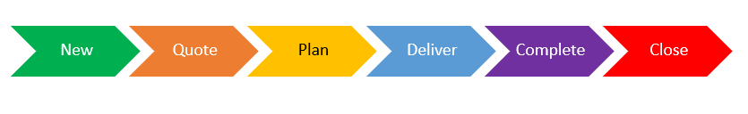
Project management
Project Operations' project management tools help with project execution by facilitating planning, estimating, and tracking.
Project stages
Project stages in Project Operations include New (project creation), Quote (associated with a quote), Plan (winning a quote), Deliver (project start), Complete (work completion), and Close (transaction recording, read-only).
Navigate the user interface
The Project page is separated into several tabs. Each tab represents a different level of detail within the project.

Slide 43
Resource management
Project stages in Project Operations include New (project creation), Quote (associated with a quote), Plan (winning a quote), Deliver (project start), Complete (work completion), and Close (transaction recording, read-only).
Bookings and assignments
Bookings are project-level allocations of resources that may or may not match task-level assignments.
Resource management modes
Project Operations supports centralized and hybrid booking modes to manage bookings.
Central mode
Central mode in Project Operations allows project managers to define resource requirements and resource managers to fulfill them.
Hybrid mode
Hybrid mode in Project Operations allows project managers and resource managers to book resources.

Slide 44
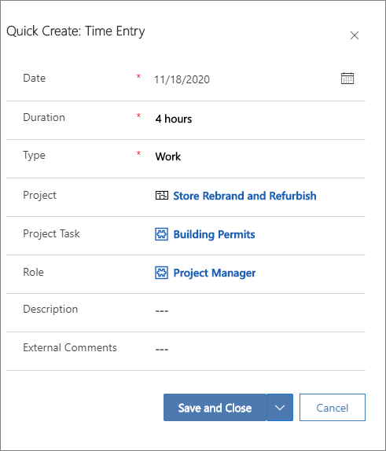
Time tracking
Time entry in Project Operations records actual time spent on tasks and notifies resource managers of potential absences.
Create a new time entry
To create a new time entry, follow these steps:
In the time entry grid, select New.
In the Quick Create: Time Entry dialog box, select the time entry date.
Enter data for the Project, Project Task, Role, and Duration dimensions. This information should be added in minutes, hours, or days by typing h, m, or d, together with the number.
Enter a description for the entry and any comments that can be shared externally regarding time entry.
Save the entry. The entered values appear in the Dimensions section. The information that was entered in the Duration field appears on the date that the time entry was created for.

Slide 45
Expense tracking
Project Operations supports expense processing with customizable workflows.
Basic deployment
Basic deployment is available for two deployment types of Project Operations.
Full deployment
Full deployment is available for two deployment types of Project Operations.
Proforma invoicing
Proforma invoices in Project Operations are different from invoices in Sales in many ways.
Configure automatic invoice creation
Project Operations can automatically create draft proforma invoices based on invoice schedules.
Create a manual proforma invoice
In Project Operations, proforma invoices can be created manually
Project Contracts list page
Create invoices for multiple project contracts by selecting them on the Project Contracts list page.

Slide 46
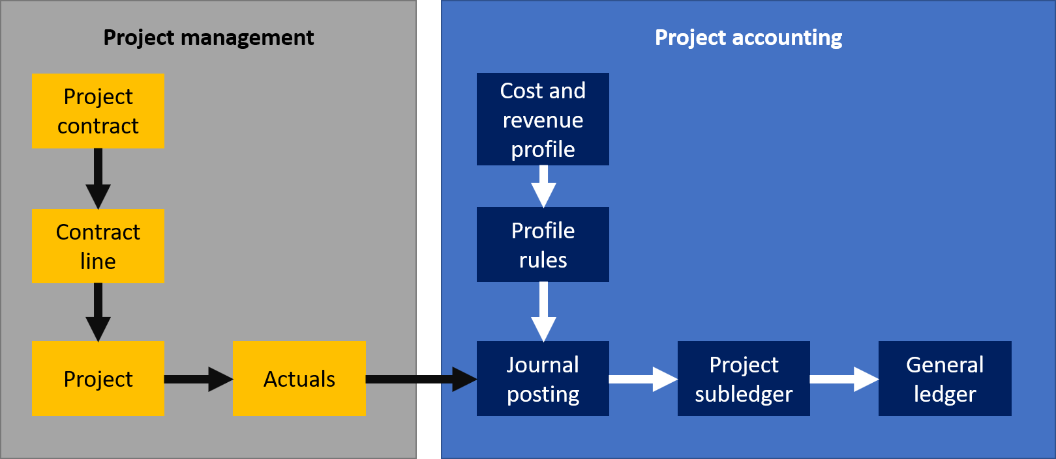
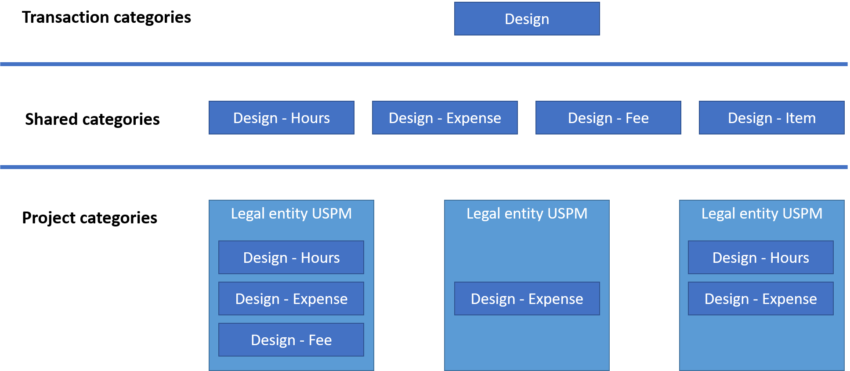
Project Contract details page
The system creates draft proforma invoices for project contracts with Ready to Invoice backlog dated before today's date.
Manage the billing backlog
The billing backlog views list unbilled sales actuals, milestones, and retainers and advances that can be marked as Ready to Invoice.
Project accounting
Accounting options for billable projects
Accounting options for internal projects
Process project costs and unbilled sales with the integration journal.
Financial dimensions
Project categories
Revenue recognition
Transactions accounted with the time and material billing method.
Transactions accounted with the fixed price billing method.

Slide 47
Get help and learn more about finance and operations apps
Introduction
Learn how to get help and find out more about finance and operations apps, as well as protecting the privacy and personal data of your customers.
Microsoft Learn site
Finance and operations application documentation
Microsoft Learn documentation provides:
A rich set of product Help topics that can be enhanced by community members both inside and outside Microsoft.
A quick way to access different types of content about the system, including topics and videos.
In-product help
View and export field descriptions
Access topics in Microsoft Learn documentation
Access task guides
Customize help topics
Task guides
Field descriptions
Protecting the privacy and personal data of your customers

Slide 48
Thank You
See you all next Saturday

